Slide 1


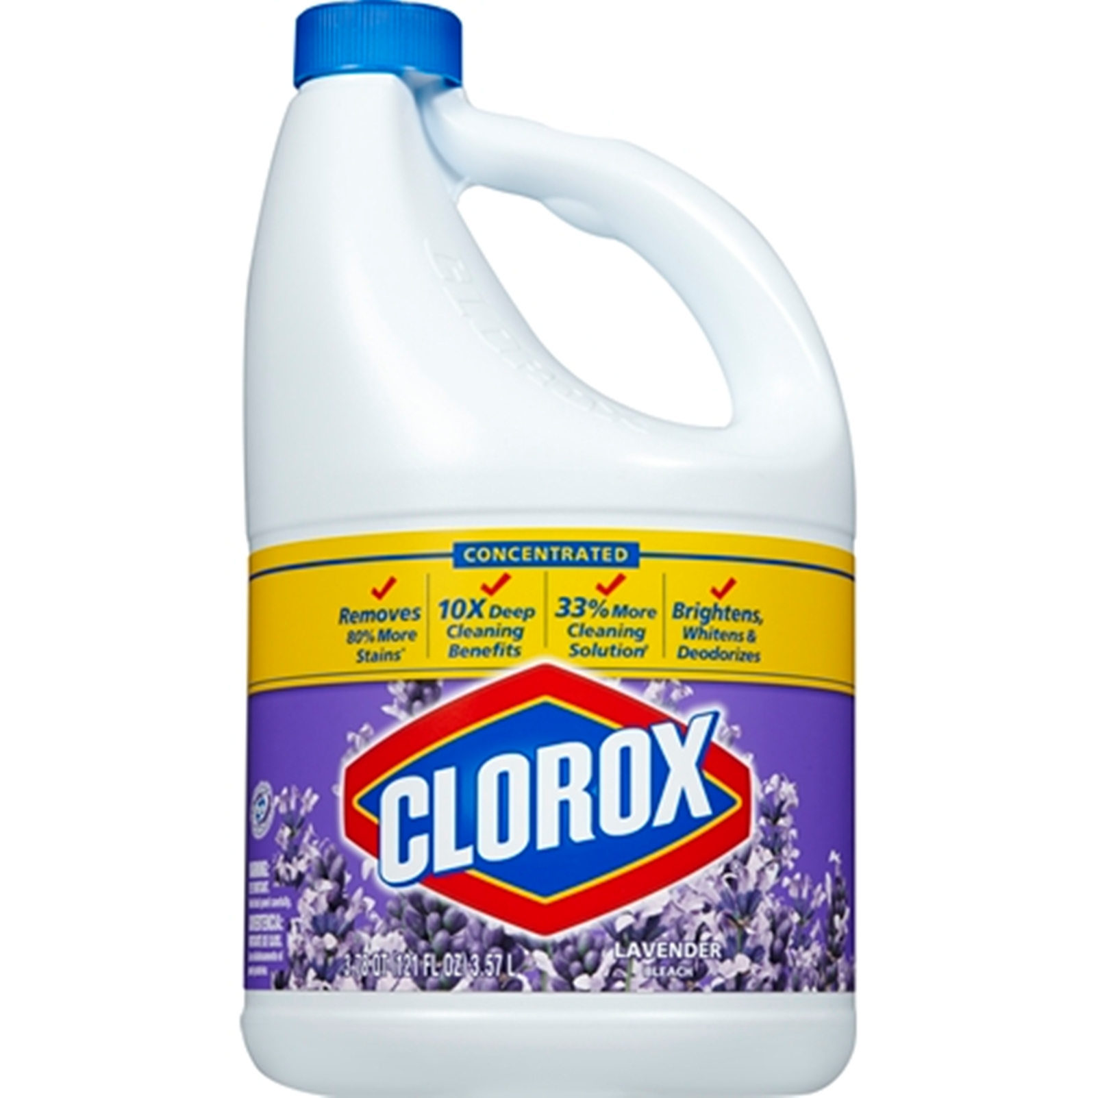

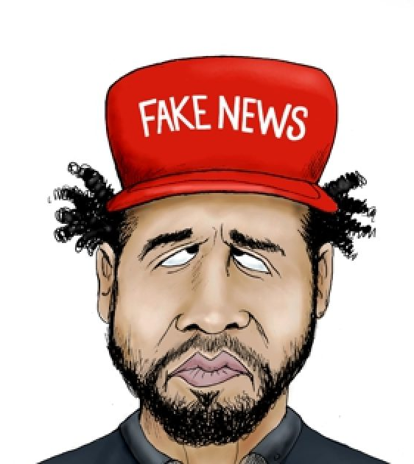
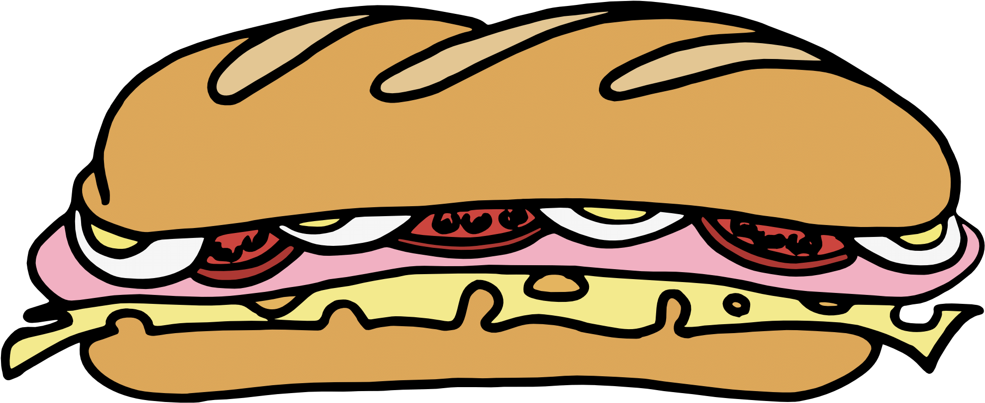

 | Renton Fish & Game Club Bay 2 Stage: Juicy Course Designer: Kris Erickson
SCENARIO: Standards: Walking back to your apartment after a sandwich run at 2 a.m. on a brisk Chicago morning, two pink pussy hat wearing "individuals" yell, "Hey! Aren't you that guy from the Redneck Comedy Tour!?”, put a rope around your neck, and are about to douse you with lavender-scented non-chlorine, eco-friendly fabric whitener. But these colors don’t run! Defend yourself and save your sandwich!
START POSITION: Standing at P1 facing squarely downrange, rope around neck, weak hand holding sandwich in front of mouth. Strong hand flat on stomach. Firearm loaded, on carpet, facing squarely downrange. |  | STRINGS: 1 SCORING: Unlimited SCORED HITS: Best 2 ROUND COUNT: 6 TARGETS: 2 IDPA START-STOP: Audible - Last shot CONCEALMENT: Required Muzzle Safe Points: 180 degree rule SO NOTES:
STAGE PROCEDURE: At the start signal, engage T1 & T2 with at least 3 rounds each while holding sandwich in weak hand. NOTES:
T1
T2
P1
https://chicago.cbslocal.com/tag/jussie-smollett-hoax/

